Slide 1
KITCHEN STAFF
UNIT 7

Slide 2
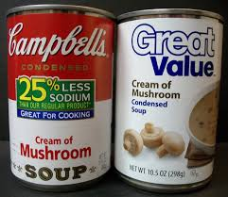
Revision:
generic product (store brand)
branded product
cover charge/service charge
on premises/on site
label

Slide 3
Take this quiz on national dishes and check your answers:
https://www.theguardian.com/travel/2020/apr/03/how-well-do-you-know-foods-of-the-world-take-our-national-dish-quiz-to-find-out

Slide 4
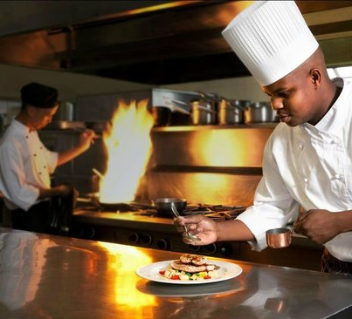
KITCHEN STAFF
chef /ςef/
sous-chef/su ςef/
cooks: fish chef, grill chef, pastry chef, pantry chef, sauce chef…
bakers
kitchen helpers
dishwashers

Slide 5
chef
main cook
also hires other staff
and plans the menu

Slide 6
to cook – make a meal
a cook – person who cooks
a cooker – appliance in the kitchen used for cooking

Slide 7
Read the text on p. 198, then answer question on p. 199, ex. 1 and 3

Slide 8
DO MAKE
TO PERFORM
to do the cooking/roasting
to do the washing-up
to do the dishes
to do homework
TO PRODUCE
to make a cake
to make a cup of coffee/tea
to make a soup/salad
to make breakfast/lunch/dinner

Slide 9
Complete the sentences with do or make, ex. 6 p. 200

Slide 10
Complete the sentences with do or make, ex. 6 p. 200
1 does
2 do
3 do
4 make
5 make
6 makes
7 does, make

Slide 11
Complete the sentences with words from the box, ex. 2 p. 202

Slide 12
Complete the sentences with words from the box, ex. 2 p. 202
1 cooks
2 cooked
3 cook
4 cooker
5 cookery
6 cooking
7 cooker
8 to cook
9 cookery book/cook book
10 cooking

Slide 13
cookbook

Slide 14
recipes

Slide 15
too many cooks spoil the broth

Slide 16
chief cook & bottle washer

