Slide 1
DISHES
UNIT 6

Slide 2
REVISION U5
spice – spicy
herb - herby
cheese - cheesy
cream - creamy
fruit – fruity
salt – salty
sugar – sugary
nut – nutty
fish - fishy
meat – meaty
fat - fatty
milk - milky
butter -buttery
garlic – garlicky
lemon - lemony
pepper – peppery

Slide 3
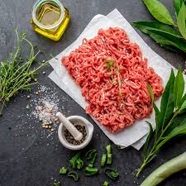
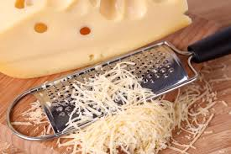
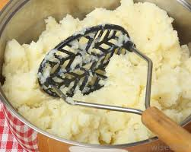
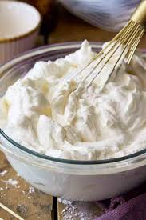
to poach eggs – poached eggs
to mince meat – minced meat
to mash potatoes – mashed potatoes
to grate cheese – grated cheese
to whip cream – whipped cream

Slide 4
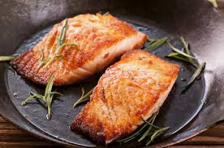
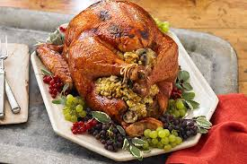
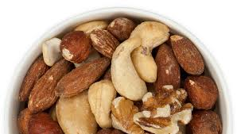
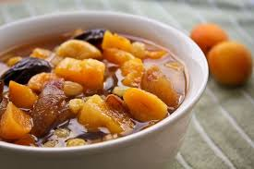
to bake beans – baked beans
to fry fish – fried fish
to salt nuts – salted nuts
to stew fruit – stewed fruit
to stuff turkey – stuffed turkey

Slide 5
Potatoes SEASONED with fresh herbs.
Vegetables SERVED with a tasty dip.
Beef COOKED in cream.
COOKED beef
BOILED potatoes
GRILLED vegetables

Slide 6
orange-flavoured pastry
home-made pate
oven-baked peppers
garlic-perfumed snails
butter-tossed vegetables
freshly-baked bread
freshly-squeezed juice

Slide 7
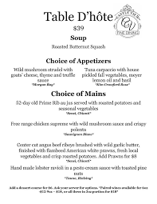
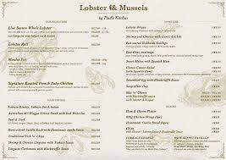
menu
a la carte
table d'hôte
selection of dishes
different prices
big choice
set menu
fixed price
daily offer

Slide 8
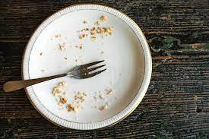
describing tastes
chocolate
dark chocolate
cheese
lemon
cake
coffee
vinegar
crisps
honey
pretzels
yoghurt
sausage
sweet
salty
sour
bitter
umami

Slide 9
describing tastes
sweet: chocolate, cake, honey
salty: crisps, pretzels
sour: lemon, vinegar, yoghurt
bitter: dark chocolate, coffee
umami: cheese, sausage

Slide 10
describing temperatures
boiling, piping hot
hot
warm
lukewarm, tepid, room-temperature
cool
cold, chilled
ice-cold, freezing

Slide 11
describing tastes
tasty, delicious, delectable, yummy, mouth-watering
rich
spicy, hot, mild
sweet, savoury

Slide 12
describing flavours
good flavours
bad flavours
tasty, delicious, delectable, yummy, mouth-watering
rich
spicy, hot, mild
sweet, savoury
tasteless, inedible, disgusting, yucky
heavy
bland
pungent

Slide 13
special diets
Which of these will a vegetarian eat?
beef/chicken/eggs/cheese/fish/nuts
Which of these will a vegan eat?
yoghurt/fruit/butter/bread/pasta/honey
Which of these shouldn’t a lactose-intolerant person eat?
bread/pizza/ice-cream/mayonnaise/yoghurt/fruit
Which of these shouldn’t a person with shellfish allergy eat?
prawns/mussels/beef/chicken/fish/crab

Slide 14
special diets
Which of these will a vegetarian eat?
eggs/cheese/fish/nuts
Which of these will a vegan eat?
fruit/bread/pasta
Which of these shouldn’t a lactose-intolerant person eat?
pizza/ ice-cream/yoghurt
Which of these shouldn’t a person with shellfish allergy eat?
prawns/mussels/crab

Slide 15
click to find out about fine dining:
and about the chef’s job:
https://www.youtube.com/watch?v=QNOYwn52y_M
https://www.youtube.com/watch?v=kW140spadx8

