Slide 1
DISHES
UNIT 5

Slide 2
REVISION Parts of Meals – course /ko:rs/
first/second course
main course
fish/meat course
three-course meal
hors d’oeuvre/starter/appetizer
entrée/main (course)
soup, salad
dessert

Slide 3
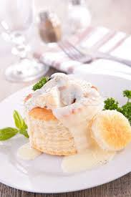
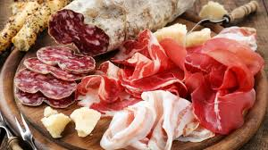
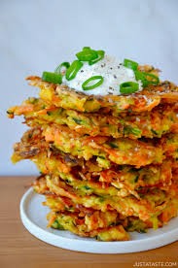
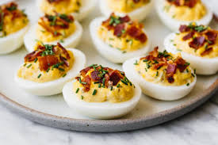
hors d’oeuvre/starter/appetizer
hot:
vols-au-vent
croquettes
rissoles
fritters
cold:
fish/seafood (smoked/marinated)
cold cuts (ham, sausages…)
stuffed eggs
vegetables

Slide 4
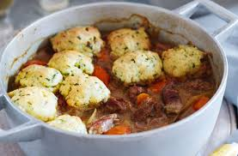
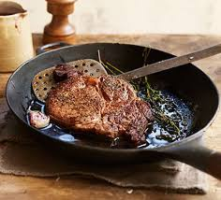
entrée/main (course)
stew
casserole
steak
hamburger
goulash
pilaff
moussaka
kebab
stewing
sautéing
frying
grilling
baking

Slide 5
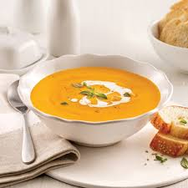
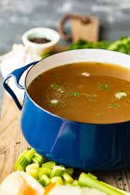
soups
vegetables
grains, pulses
meat, fish, poultry
stock, consommé
broth
cream soup/potage
bouillon

Slide 6
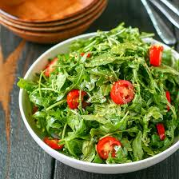
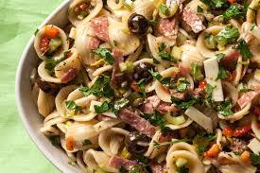
salads
green + dressing (vinaigrette):
lettuce
rocket
endive
chicory
lamb’s lettuce
plain:
vegetables (raw/cooked)
compound/combination:
vegetables (fruit)
pasta, rice
fish, meat

Slide 7
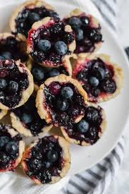
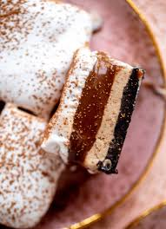
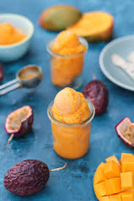
dessert
pies, tarts, cakes, gateaux
pancakes, donuts
mousse, souffle
pudding
fruit salad, preserves, compote
ice cream, sorbet, parfait
puff pastry
choux pastry
sponge
meringue
glazing/coating/icing

Slide 8
Server is also called a W - - - - -.
Container for drinks is G - - - - .
Server’s S - - - - - - is a group of tables they are responsible for.
T - - is extra money given for good service.
Serviette is also called a N - - - - - .
O - - - - is the food and drink requested by a guest.
You R - - - - - - - something when you have no more of it.

Slide 9
server or waiter
glass (of water, wine, juice...)
station
tip for good service
order is food requested
run out of (milk, sugar, money, fuel...)

Slide 10
UNIT 5 Description of Dishes

Slide 11
read the Menu (p. 183) and answer questions:
What is offered as a starter?
What dishes are the main course?
What meat is the main course?
What is offered as dessert?
What methods of cooking are described?

Slide 12
match (ex. 2, p. 184)
blazed
garnished
topped
enclosed
cooked
seasoned
coated
poached
with bread crumbs/chocolate sauce
with mushrooms
in red wine
in slices of sponge cake
with fresh herbs
in brandy
in vanilla syrup
with glazed onions

Slide 13
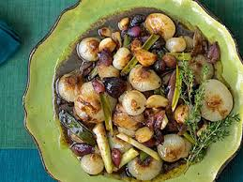
match (ex. 2, p. 184)
blazed in brandy
garnished with glazed onions
topped with mushrooms
enclosed in slices of sponge cake
cooked in vanilla syrup
seasoned with fresh herbs
coated with bread crumbs/chocolate sauce
poached in red wine

Slide 14
odd one out (ex. 4, p. 185)
mango, avocado, pear, hazelnut
leek, basil, pepper, asparagus, garlic
veal, beef, calf, pork
prawn, shrimp, lobster, squid

Slide 15
odd one out (ex. 4, p. 185)
mango, avocado, pear, hazelnut
leek, basil, pepper, asparagus, garlic
veal, beef, calf, pork (animal, not meat)
prawn, shrimp, lobster, squid (no shell)

Slide 16
make adjectives by adding –Y to nouns (ex. 5) nut – nutty/taste – tasty/pepper – peppery
spice
herb
cheese
cream
fruit
salt
sugar
fish
meat
fat
milk
butter
garlic
lemon

Slide 17
make adjectives by adding –Y to nouns (ex. 5) nut – nutty/taste – tasty/pepper – peppery
spice – spicy
herb - herby
cheese - cheesy
cream - creamy
fruit – fruity
salt – salty
sugar - sugary
fish - fishy
meat – meaty
fat - fatty
milk - milky
butter -buttery
garlic – garlicky
lemon - lemony

Slide 18
use some of the adjectives to complete
The salad dressing is nice and …
The wine has a delicious … bouquet.
This bacon is too …
The chocolate mousse is smooth and …
This sauce is very …

Slide 19
use some of the adjectives to complete
The salad dressing is nice and herby.
The wine has a delicious fruity/nutty bouquet.
This bacon is too salty/fatty.
The chocolate mousse is smooth and creamy.
This sauce is very buttery/lemony/garlicky.

Slide 20
describing dishes – past participle (verb + ED) p. 186
Potatoes SEASONED with fresh herbs.
Vegetables SERVED with a tasty dip.
Beef COOKED in cream.
COOKED beef
BOILED potatoes
GRILLED vegetables

Slide 21
describing dishes – past participle (verb + ED) ex. 6, p. 186
to poach eggs
to mince meat
to mash potatoes
to grate cheese
to whip cream
to bake beans
to fry fish
to salt nuts
to stew fruit
to stuff turkey

Slide 22
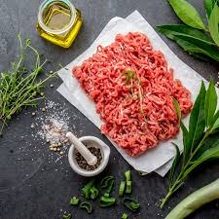
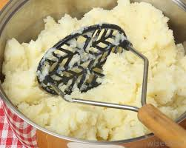
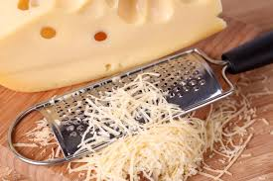
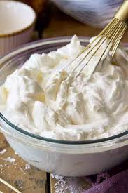
describing dishes – past participle (verb + ED) ex. 6, p. 186
to poach eggs – poached eggs
to mince meat – minced meat
to mash potatoes – mashed potatoes
to grate cheese – grated cheese
to whip cream – whipped cream

Slide 23
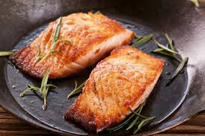
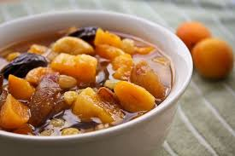
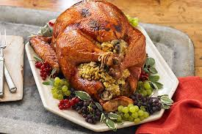
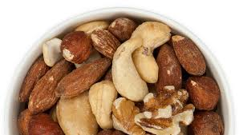
describing dishes – past participle (verb + ED) ex. 6, p. 186
to bake beans – baked beans
to fry fish – fried fish
to salt nuts – salted nuts
to stew fruit – stewed fruit
to stuff turkey – stuffed turkey

Slide 24
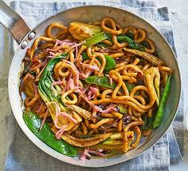
describing dishes – past participle (verb + ED) combined with other words pp. 186-187
fried in a pan – PAN-FRIED
soaked with brandy – BRANDY-SOAKED
FRESHLY-GROUND COFFEE
FINELY-CHOPPED ONIONS

Slide 25
make adjectives for underlined nouns ex. 8, p. 188
to flavour pastry with orange
to make pate at home
to bake peppers in oven
to perfume snails with garlic
to toss vegetables in butter
to bake fresh bread
to squeeze fresh juice

Slide 26
make adjectives for underlined nouns ex. 8, p. 188
orange-flavoured pastry
home-made pate
oven-baked peppers
garlic-perfumed snails
butter-tossed vegetables
freshly-baked bread
freshly-squeezed juice

Slide 27
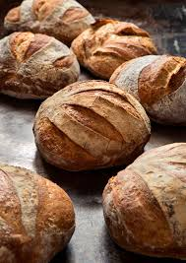
coffee – roasted, ground, freshly-brewed
flour – ground, sifted
meat – minced, grilled, roasted, boiled, sautéed, braised, stewed, stuffed
fish – grilled, smoked, boiled
ham – smoked, boiled, honey-glazed
egg – boiled, poached, fried
bread – freshly-baked, home-made
vegetables – chopped, diced, grilled, boiled, stewed
potatoes – oven-baked, boiled, mashed
onions – sautéed, finely-chopped

