Slide 1
MEAL COURSES
UNIT 4

Slide 2
revision U3 herbs spices
parsley
mint
dill
basil
sage
rosemary
thyme
coriander
bay leaves
oregano
salt
pepper
sugar
cinnamon
nutmeg
clove
cumin
paprika
turmeric

Slide 3
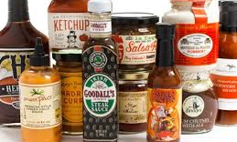
condiment
spice or sauce added, usually after cooking, to taste and available on the table
salt, pepper
oil, vinegar
ketchup
soy sauce
mustard

Slide 4
Styles of Table Service
French or gueridon /geridon/
Russian or silver
American or plate

Slide 5
French or gueridon table service
fancy, luxurious restaurants with a la carte menu
dishes are brought on a trolley (gueridon) from the kitchen to dining room
dish is presented to guests, admired by them, then carved or filleted, flambéed

Slide 6
Russian or silver table service
menu is a la carte or table d'hôte in hotel restaurants
food is carved or filleted in the kitchen, taken to dining room on silver platters

Slide 7
American or plate table service
restaurants with table d'hôte menu
food is placed on plates in the kitchen and brought to guests

Slide 8
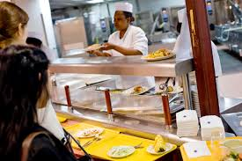
self-service
no waiters
fast-food restaurants, bars & cafes, canteens
guests take trays and cutlery
they choose meals from the counter
they take them to tables to eat

Slide 9
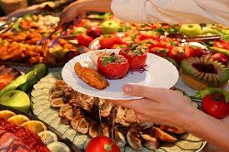
buffet
no waiters
hotel meals, catering for events
guests fill their plates at a large table
they take them to tables to eat

Slide 10
When you S – - a table, you put plates, forks, knives.
Customer asks for a B – - - at the end of a meal.
S - - - - - - - are dishes a restaurant is promoting.
We eat with a K - - - - and a fork.
Reservation or B - - - - - - .
D - - - - - - is a sweet dish served after the main course.
Number of customers served during a shift is called C - - - - -.

Slide 11
set the table
ask for a bill
restaurant is promoting specials
fork and knife
booking is reservation
dessert is sweet dish
covers

Slide 12
Parts of Meals – course /ko:rs/
first/second course
main course
fish/meat course
three-course meal
hors d’oeuvre/starter/appetizer
entrée/main (course)
soup, salad
dessert

Slide 13
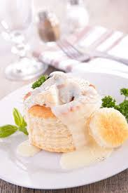
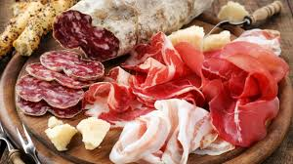
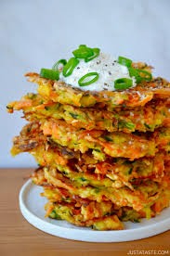
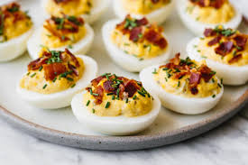
hors d’oeuvre/starter/appetizer
hot:
vols-au-vent
croquettes
rissoles
fritters
cold:
fish/seafood (smoked/marinated)
cold cuts (ham, sausages…)
stuffed eggs
vegetables

Slide 14
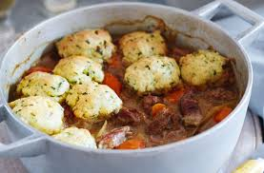
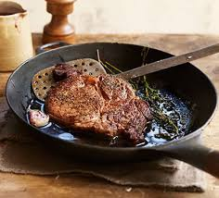
entrée/main (course)
stew
casserole
steak
hamburger
goulash
pilaff
moussaka
kebab
stewing
sautéing
frying
grilling
baking

Slide 15
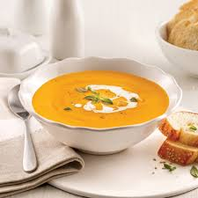
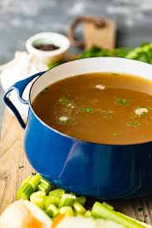
soups
vegetables
grains, pulses
meat, fish, poultry
stock, consommé
broth
cream soup/potage
bouillon

Slide 16
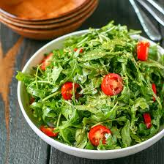
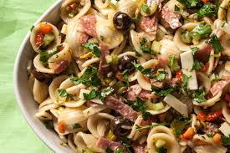
salads
green + dressing (vinaigrette):
lettuce
rocket
endive
chicory
lamb’s lettuce
plain:
vegetables (raw/cooked)
compound/combination:
vegetables (fruit)
pasta, rice
fish, meat

Slide 17
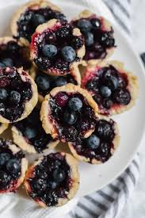
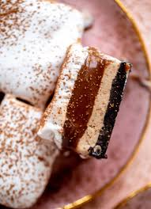
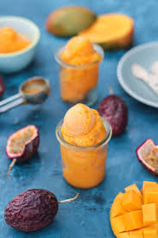
dessert
pies, tarts, cakes, gateaux
pancakes, donuts
mousse, souffle
pudding
fruit salad, preserves, compote
ice cream, sorbet, parfait
puff pastry
choux pastry
sponge
meringue
glazing/coating/icing

Slide 19
savouries (after or instead of sweet dish)
cheese platter
mushroom/sardines on toast

Slide 20
The seafood salad … a creamy, lemon dressing … olive oil, vinegar, yoghurt, mayonnaise and lemon. Our Florentine steak is … sea salt and black pepper, and … white beans. Try the tasty beef Milanese. It’s … egg and breadcrumbs, then fried. The chicken is … lemon juice, olive oil and garlic overnight, and then barbecued.
coated in, comes with, made with, marinated in, seasoned with, served with

Slide 21
The seafood salad comes with a creamy, lemon dressing made with olive oil, vinegar, yoghurt, mayonnaise and lemon. Our Florentine steak is seasoned with sea salt and black pepper, and served with white beans. Try the tasty beef Milanese. It’s coated in egg and breadcrumbs, then fried. The chicken is marinated in lemon juice, olive oil and garlic overnight, and then barbecued.

Slide 22
rich savoury spicy sweet tender
… meat is soft. It is easy to cut and eat.
… food has been flavoured and often has a hot, burning taste.
… food is prepared with sugar.
… food has a salty flavour.
… meal usually contains a large amount of cream or butter.

Slide 23
Tender meat is soft. It is easy to cut and eat.
Spicy food has been flavoured and often has a hot, burning taste.
Sweet food is prepared with sugar.
Savoury food has a salty flavour.
Rich meal usually contains a large amount of cream or butter.

