Slide 1
HOTEL SERVICES
UNIT 9

Slide 2
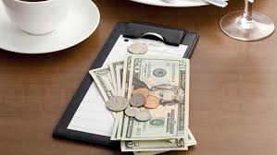
PAYING THE BILL revision UNIT 8

Slide 3
VAT = Value Added Tax

Slide 4
item – separate thing to itemise/itemize – list things separately
How many items of baggage are you checking in?
There are different items in this list.
Everything in the bill is itemized: mini-bar, phone calls, gym.

Slide 5
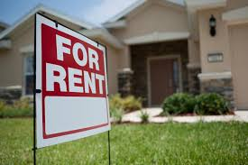
to hire = to rent
pay for using something for some period
rent a flat
rent a car
hire a driver/guide/chef

Slide 6
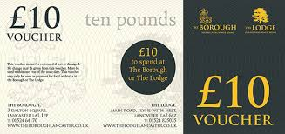
voucher = paper showing that service is paid and can be used
hotel voucher
lunch voucher
gift voucher

Slide 7
meal plan = what is included in the room rate
room only = no meals included
bed & breakfast = overnight stay and meal in the morning
half board (HB) = room and two meals = modified American plan (MAP)
full board (FB) = room and all three meals = American plan (AP)

Slide 8
gratuity (grat) = tip 1, extra money given for service
tip 2 = advice, tips & tricks

Slide 9
reduction = discount

Slide 10
HOTEL SERVICES & FACILITIES

Slide 11
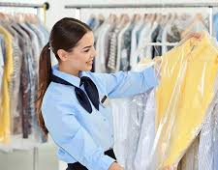
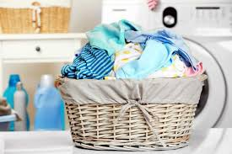
dry cleaning & laundry

Slide 12
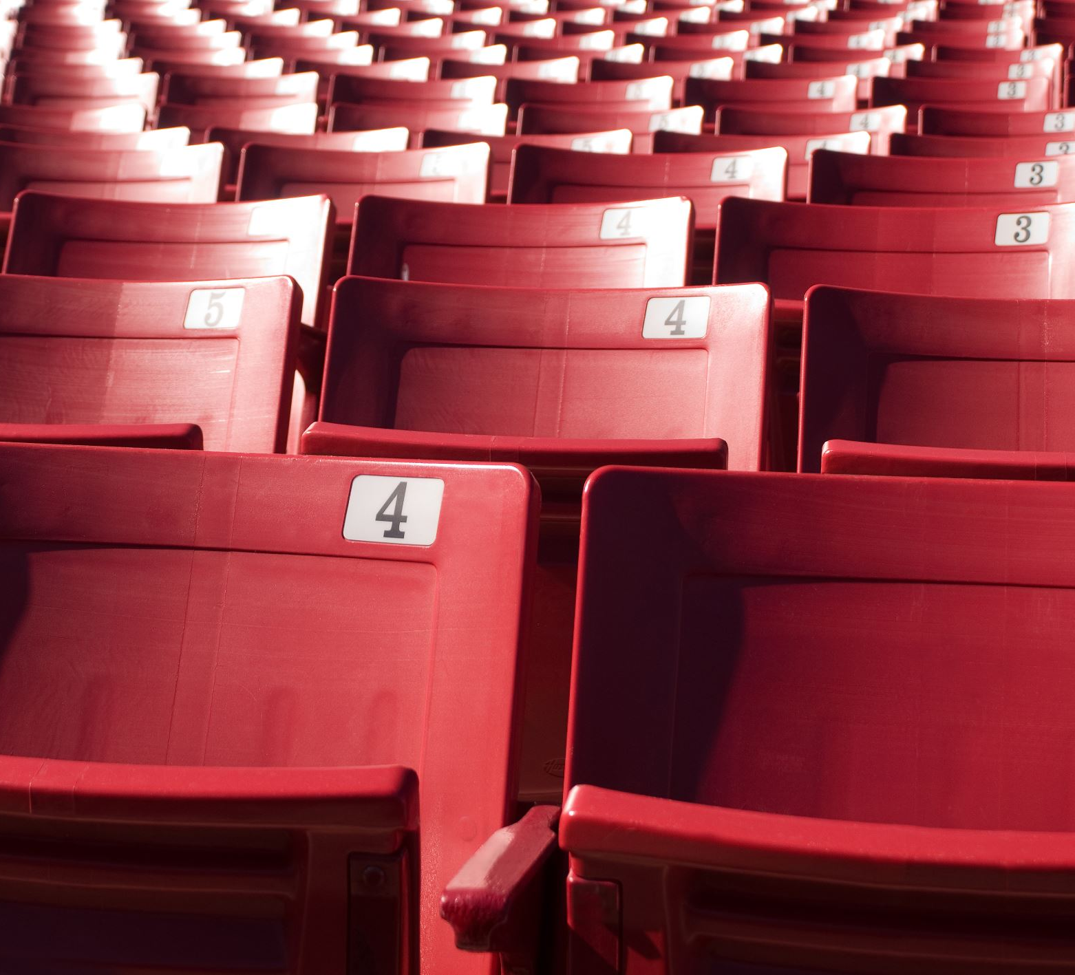
entertainment
cinema
theatre
concerts
stand-up
ballet

Slide 13
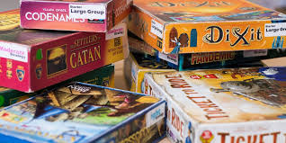
games
board games

Slide 14
golf
golf course
golf clubs

Slide 15
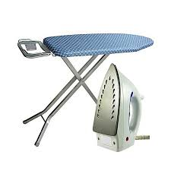
ironing
iron
ironing board

Slide 16
taxi
booking a taxi
taxi = cab

Slide 17
stationery
pen & paper

Slide 18
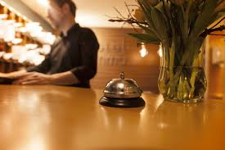
night porter
available in some hotels after 10pm

Slide 19
newspapers

Slide 20
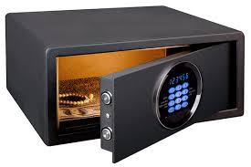
safe/safety deposit

Slide 21
food & beverage (=drinks)
restaurant
bar
room service

Slide 22
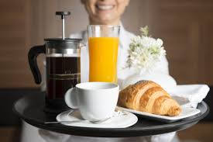
room service
when food is brought to the room

Slide 23
complimentary = free of charge
complimentary coffee
complimentary glass of wine
complimentary dessert

Slide 24
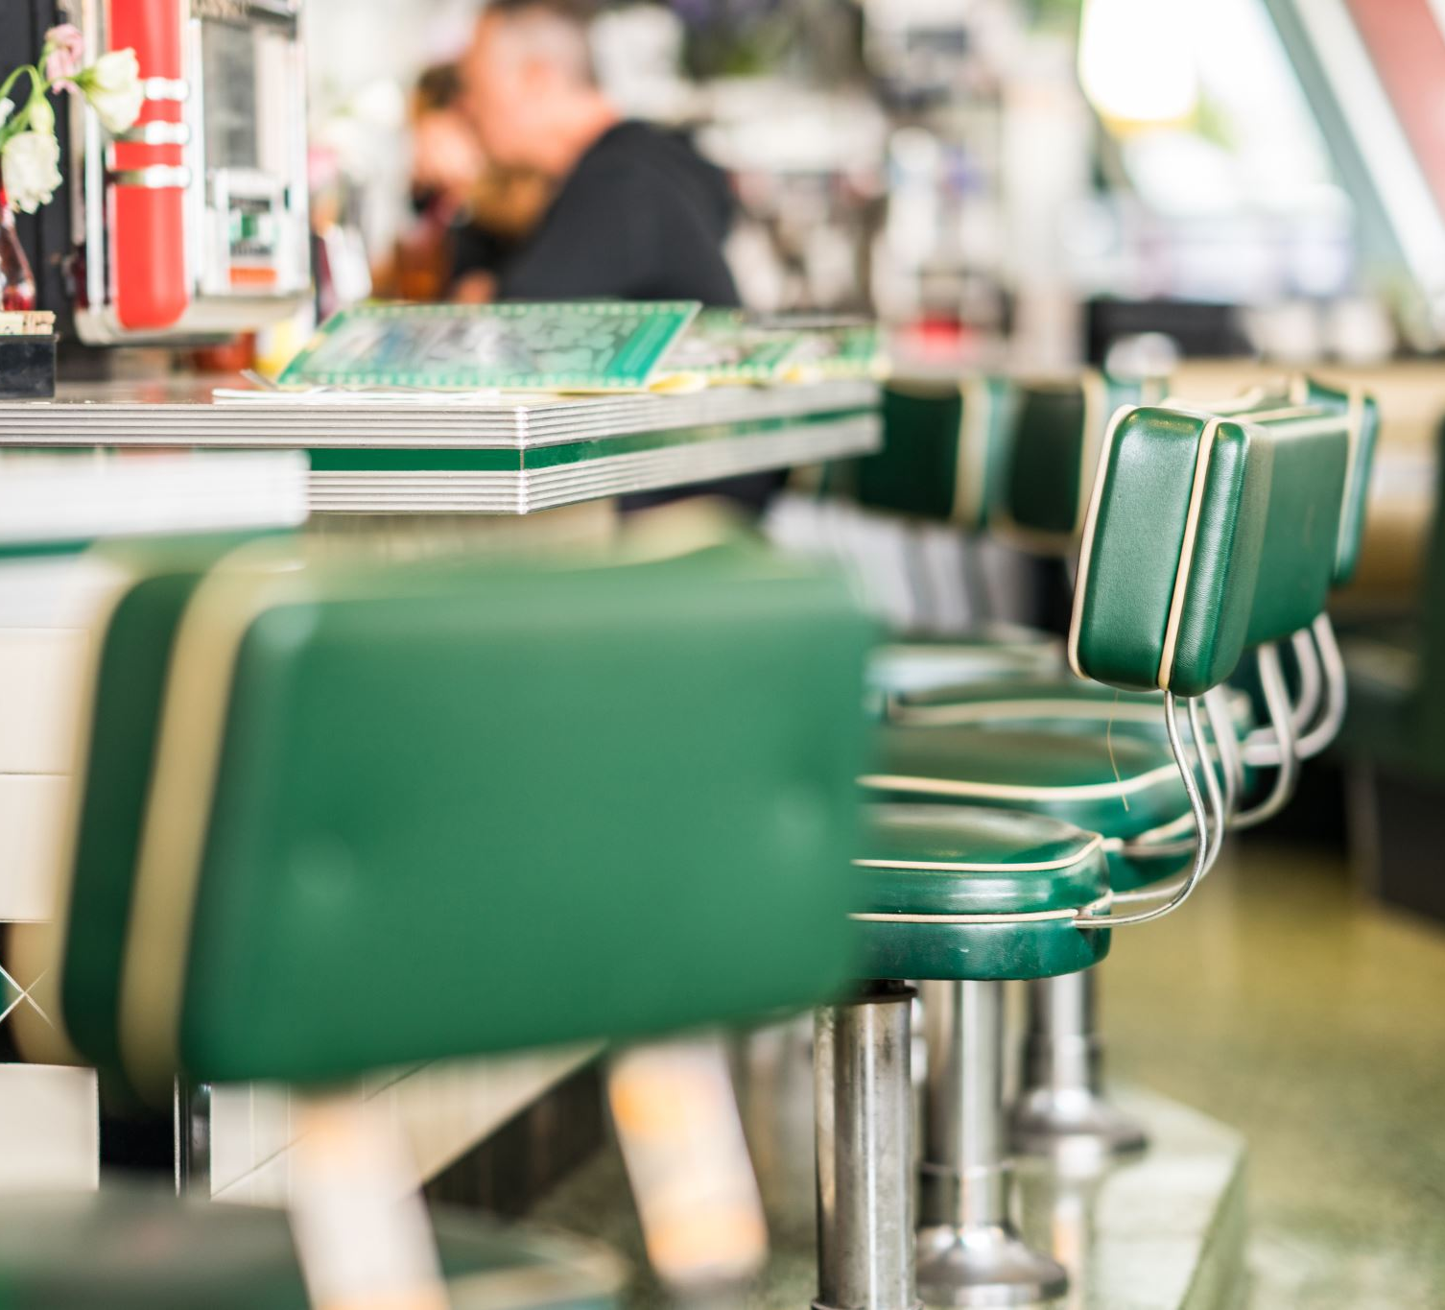
dining facilities
bar
café
restaurant
pastry shop
banqueting room

Slide 25
banqueting facilities
providing food & service for a special event, e.g. wedding, conference

Slide 26
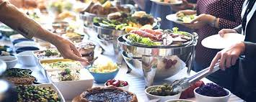
meals
breakfast
(continental, English,
buffet/b∂fei/)
lunch
dinner

Slide 27
uniformed services
bell person
concierge
valet /v∂lei/ parking

Slide 28
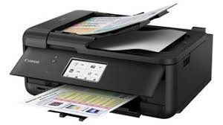
office support
secretarial services
translation
printing & photocopying

Slide 29
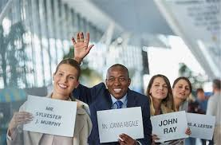
hotel transfer
airport pick-up
limousine service
courtesy van

Slide 30
other services & equipment
wake-up call
parking
extra bed
crib/cot
extra linen, towels, pillows, blankets

Slide 31
informing quests about services & facilities
The hotel provides/offers…
Room service is available…
The hotel has (hasn’t) got…
There is (isn’t)…/are (aren’t)…
The receptionist can arrange…

Slide 32
working hours
The restaurant is open from … to …
The bar opens at … and closes at …

Slide 33
location
The bar is on the ground floor, just across the lobby.
The beach is a five-minute walk from here.
You can find it if you go …

Slide 34
PASSIVE
Paper is provided in the drawer.
AM/IS/ARE + past participle (-ed/III)
Newspapers may be ordered at the reception.
Keys should be left at the reception.
modal verb (CAN/MAY/SHOULD/MUST) + be + past participle (-ed/III)

Slide 35
You may order newspapers at the reception.
You may park your car in our garage.
You may obtain a free pass at the front desk.
You should leave the key at the reception.
You may exchange foreign currency at the exchange office.
You can rent a car at the agency.
We serve coffee in the foyer.
You should inform the receptionist if you check out late.
You can taste traditional dishes at our restaurant.

Slide 36
provide/refer/follow up/handle/meet/ record/contact/arrange/make
I tried to … him at his office but he wasn’t in.
We haven’t found a house that … our needs.
The receptionist’s duty is to … all complaints and requests.
The guest asked for additional hangers and the receptionist … the request to housekeeping.
Receptionists are obliged to … on every request to be sure it is fulfilled.
The duty of concierge is to … guests’ requests.
A concierge would … reservations for dining, … for theatre tickets and transportation, and … information on cultural events.

Slide 37
provide/refer/follow up/handle/meet/ record/contact/arrange/make
I tried to contact him at his office but he wasn’t in.
We haven’t found a house that meets our needs.
The receptionist’s duty is to record all complaints and requests.
The guest asked for additional hangers and the receptionist referred the request to housekeeping.
Receptionists are obliged to follow up on every request to be sure it is fulfilled.
The duty of concierge is to handle guests’ requests.
A concierge would make reservations for dining, arrange for theatre tickets and transportation, and provide information on cultural events.

Slide 38
match the words
wake-up
newspaper
transportation
entertainment
airport
banquet
language
complimentary
valet
car
translation
rental
pick-up
parking
arrangements
reservations
calls
delivery
meal service
morning coffee

Slide 39
match the words
wake-up
newspaper
transportation
entertainment
airport
banquet
language
complimentary
valet
car
calls
delivery
arrangements
reservations
pick-up
meal service
translation
morning coffee
parking
rental

Slide 40
item/receipt/safe/brochure/premises/supply/loan/stationery/folder
amount of something available for use
something which is part of a list or group
borrowing or lending something
piece of paper proving that money, goods have been received
land and building owned by a company
things for writing, paper, pens…
plastic or cardboard used for keeping paper
small book with information and pictures
strong box for keeping valuables

Slide 41
item/receipt/safe/brochure/premises/supply/loan/stationery/folder
amount of something available for use supply
something which is part of a list or group item
borrowing or lending something loan
piece of paper proving that money, goods have been received receipt
land and building owned by a company premises
things for writing, paper, pens… stationery
plastic or cardboard used for keeping paper folder
small book with information and pictures brochure
strong box for keeping valuables safe

Slide 42
item/receipt/brochure/premises/supply/loan/folder
There is no paper in the …
Iron and ironing board are available on …
Our bar has a good … of drinks.
Smoking is not allowed anywhere on hotel …
Guest can learn about attractions from a …
The hotel advises guests to keep a valuable … in the safe.
When you leave your valuables at the reception, you get a …

Slide 43
item/receipt/brochure/premises/supply/loan/folder
There is no paper in the … folder
Iron and ironing board are available on loan
Our bar has a good supply of drinks.
Smoking is not allowed anywhere on hotel premises
Guest can learn about attractions from a brochure
The hotel advises guests to keep a valuable items in the safe.
When you leave your valuables at the reception, you get a receipt

Slide 44
internet/secretarial/translation/computer/audio-visual/conference/exercise/sauna/tour guide/beauty/health and fitness/indoor pool
We have a fully equipped business centre, including … rooms with all the latest … equipment. Our range of hi-tech … services includes full … access. We can arrange full … services plus a … in several languages. Enjoy the wonderful views of the mountains as you work out in our … club, with top-notch … equipment. Visit the … salon. Relax in the … or go for a swim in the heated … . If you would like to go sightseeing, we can arrange for a … to show you the attractions.

Slide 45
internet/secretarial/translation/computer/audio-visual/conference/exercise/sauna/tour guide/beauty/health and fitness/indoor pool
We have a fully equipped business centre, including conference rooms with all the latest audio-visual equipment. Our range of hi-tech computer services includes full internet access. We can arrange full secretarial services plus a translation in several languages. Enjoy the wonderful views of the mountains as you work out in our health and fitness club, with top-notch exercise equipment. Visit the beauty salon. Relax in the sauna or go for a swim in the heated indoor pool . If you would like to go sightseeing, we can arrange for a tour guide to show you the attractions.

Slide 46
equipped/private/available/cuisine/wear/elegant/capacity/banqueting/lounge/pastry/choice
Our hotel has an excellent … of dining facilities. Besides the restaurant with the bar, there is a … shop, a cocktail … and a … room. The restaurant is spacious and … . It is located on the ground floor. The restaurant … is 120 covers. It is open for breakfast, lunch and dinner. Guests must … jacket and tie after 6pm. The restaurant is famous for its fine … . It serves classical French and British dishes. A traditional English breakfast is … in the morning. Our … dining and meeting rooms are suitable for meetings and receptions. They are … with business and presentation facilities.

Slide 47
equipped/private/available/cuisine/wear/elegant/capacity/banqueting/lounge/pastry/choice
Our hotel has an excellent choice of dining facilities. Besides the restaurant with the bar, there is a pastry shop, a cocktail lounge and a banqueting room. The restaurant is spacious and elegant. It is located on the ground floor. The restaurant capacity is 120 covers. It is open for breakfast, lunch and dinner. Guests must wear jacket and tie after 6pm. The restaurant is famous for its fine cuisine. It serves classical French and British dishes. A traditional English breakfast is available in the morning. Our private dining and meeting rooms are suitable for meetings and receptions. They are equipped with business and presentation facilities.

Slide 48
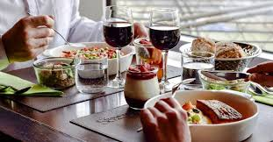
restaurant capacity = number of covers (guests served at a table)

Slide 49
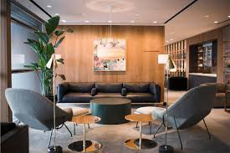
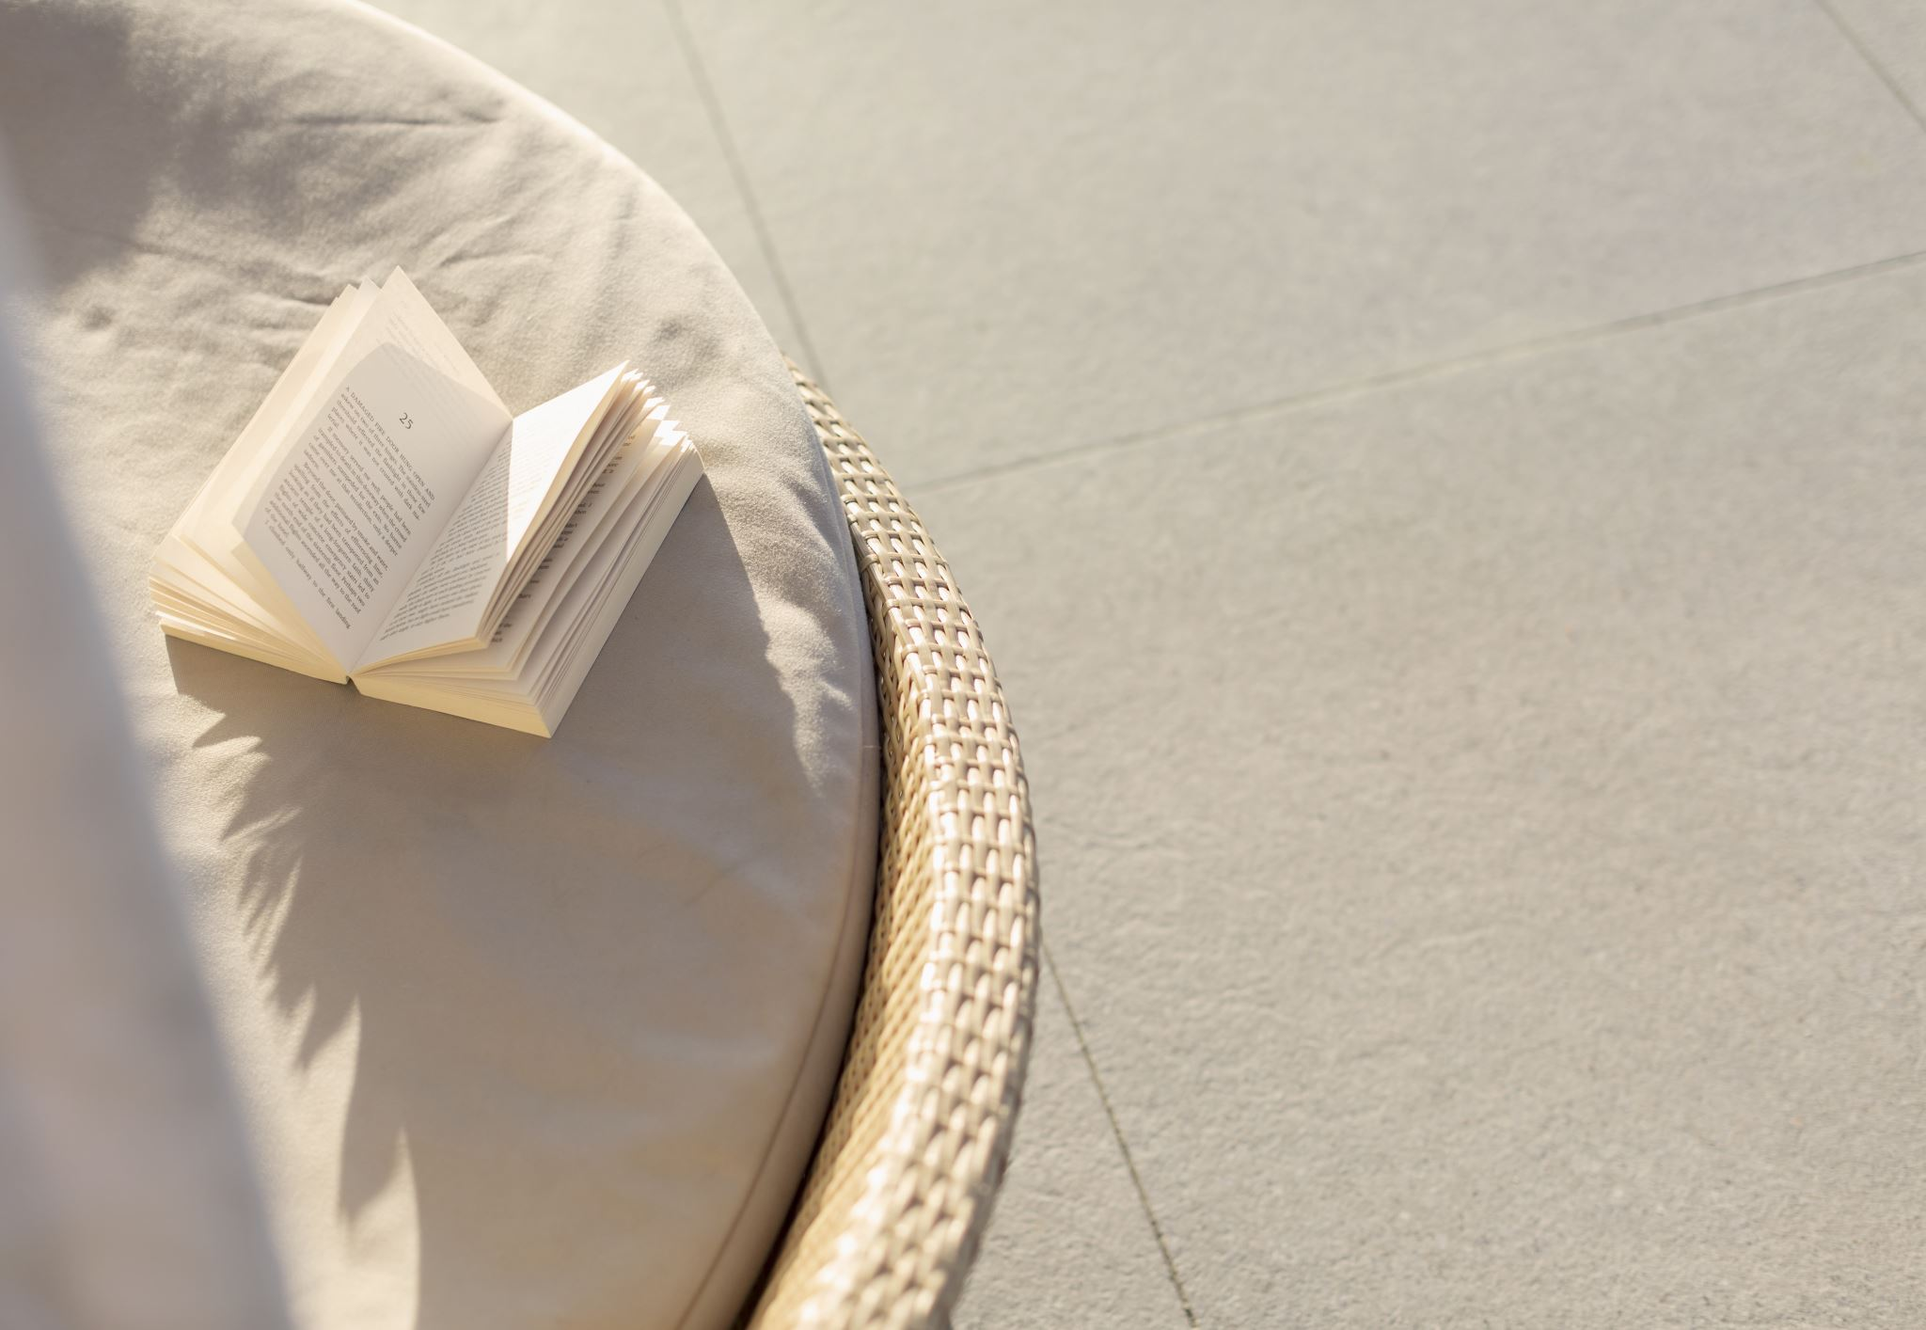
lounge /laundʒ/
public space to sit and relax (or wait)
hotel lounge
cocktail lounge
departure lounge at airport
living room at home

Slide 50
pastry
baked products made from flour (eggs, milk..)
sweet or savoury
pastry chef (plus cakes, ice cream, bread)

Slide 51
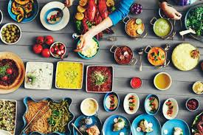
cuisine kitchen
Italian/Chinese
national/traditional
dish/specialty/food

Slide 52
Winter Palace – hotel and conference centre
parking (100 cars)
souvenir & gift shop
hairdressing salon
fitness centre with pool and sauna
playground for children
business centre & secretarial services
audio-visual equipment
two restaurants with international and local cuisine, bar & lounge
room service 24/7

