Slide 1
COMPLAINTS
UNIT 12

Slide 2
customer satisfaction/ dissatisfaction
satisfied
happy
pleased
dissatisfied
unhappy
angry

Slide 3
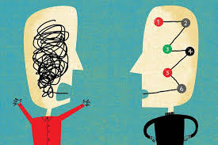
complaints

Slide 4
to complain – say something is wrong
complaint – to make a complaint, to file a complaint, a letter of complaint
to deal with a complaint/
to handle a complaint

Slide 5
types of complaints in hotels
mechanical
attitudinal/
BEHAVIOURAL
service-related
unusual

Slide 6
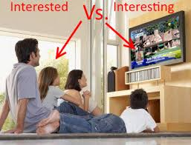
adjectives something/somebody -ING somebody -ED
frustrating
annoying
upsetting
boring
amusing
interesting
frustrated
annoyed
upset
bored
amused
interested

Slide 7
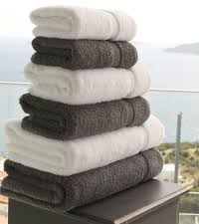
bed linen/towels
dirty/stained
wet/damp
torn

Slide 8
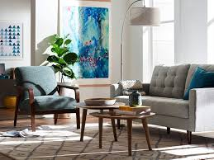
furniture
uncomfortable
broken
dusty
stuck

Slide 9
equipment
broken down/
not working/
out of order
noisy/too loud
no heating
no AC
no light

Slide 10
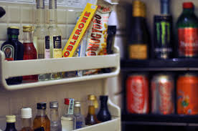
mini bar
empty
no selection

Slide 11
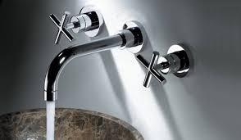
bathroom
no (hot) water
no water pressure
no hairdryer
no shower curtain
tap is leaking
toilet doesn’t flush
bath is clogged

Slide 12
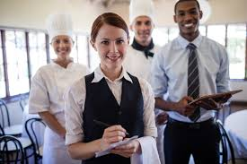
service/staff
rude/impolite
slow/inefficient

Slide 13
handling a complaint
apology
action

Slide 14
apology
I’m really sorry for your inconvenience.
I apologize for the mistake.
I’m very sorry to hear that…

Slide 15
action
I’ll have the heating turned up.
I’ll get the maid to clean the room.
I’ll see to it right away.

Slide 16
ONE/ONES
I need another towel. This one is dirty.
I’m sorry, I’ll bring you a new one.
I’d like to buy some flowers.
Which ones do you like, the red or yellow ones?

Slide 17
better/clean/different/new/old/dry/larger + one(s)
This cup is dirty. Can I have ….?
This towel is wet. Bring me … .
I’m going to sell my car and buy … .
That’s not a good photo, this is … .
I want today’s newspaper. This is …
This room is too small. I need … .
Why do we go to the same restaurant? Let’s go to ….

Slide 18
GET/HAVE ST DONE (-ED/3. irregular)
asking/paying someone to do something for us
I’ll have the tap repaired (call the plumber)
I’ll repair the tap (do it myself)
She had the cake made (ordered from the pastry shop)
She made the cake (did it herself)

Slide 19
reply to complaints using get/have st done
The mirror is dusty. (clean)
The minibar is frosted and the door is stuck. (fix)
The bath is dirty. (clean)
The AC isn’t working. (repair)
The tap won’t turn. (mend)
The shower curtain is torn. (replace)
The toilet won’t flush. (fix)
There are no towels. (send up)
There are no toiletries. (deliver)

