Slide 1
SEAFOOD
LEARN THE FOLLOWING WORDS

Slide 2
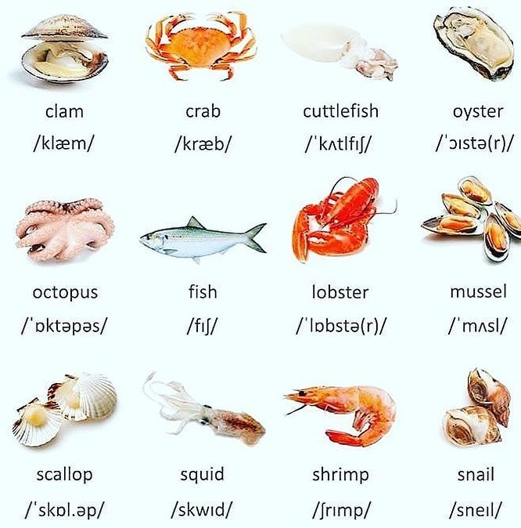

Slide 3
SEAFOOD
PRACTISE THE SEAFOOD WORDS IN THE FOLLOWING SLIDE
NAME THE SEAFOOD
CHECK YOUR ANSWERS (SLIDE 2)

Slide 4
1
2
3
4
5
6
7
8
9
10
11
12

Slide 5
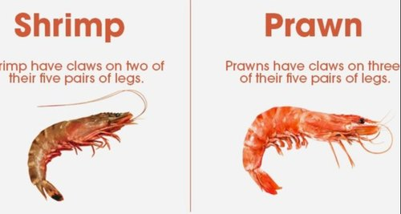

Slide 6
SEAFOOD
clam školjka crab kraba cuttlefish sipa oyster ostriga octopus hobotnica lobster jastog mussel dagnja scallop jakopska kapica (školjka) squid lignja shrimp kozica (siva) prawn kozica (crvena) snail puž

Slide 7
SEAFOOD
LET`S CHECK ONCE AGAIN

Slide 8
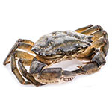
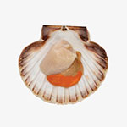
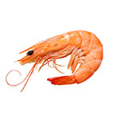
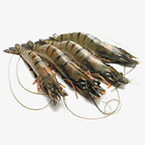
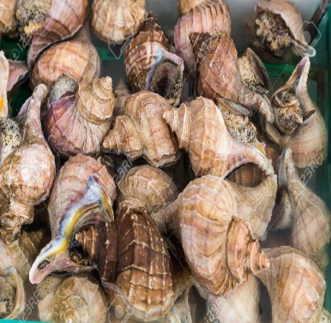
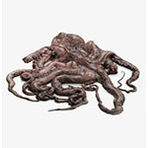
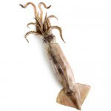
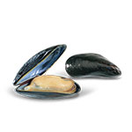
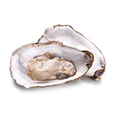
crab
scallop
shrimp
prawn
snail
octopus
squid
mussel
oyster

Slide 9
FISH OR SEAFOOD?
prawns
sardines
squid
oysters
hake
crab
trout
lobster
cod
sole

Slide 10
FISH OR SEAFOOD?
prawns
sardines
squid
oysters
hake
crab
trout
lobster
cod
sole

