Slide 1
FISH

Slide 2
FISH carp /ka:p/ šaran trout /traut/ pastrmka cod /kɔd/ bakalar haddock /`hædək/ bakalar mackerel /`mækərəl/ skuša hake /heik/ oslić salmon /`sæmən/ losos sole /səul/ list catfish /ˈkatfɪʃ/ som | anchovy /`ænʧəvi/ inćun sardine /`sa:di:n/ sardina herring /`heriŋ/ haringa sterlet /`stə:lit/ kečiga pike /paik/ štuka perch grgeč pike-perch smuđ

Slide 3
FISH UNSCRAMBLE THE FOLLOWING WORDS
kahe
doc
racp
lose
rhenrig
tourt
trleste
hdaocdk
mosanl
ahyvonc
ckemelar

Slide 4
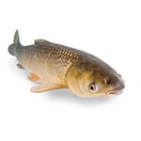
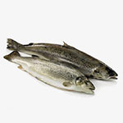
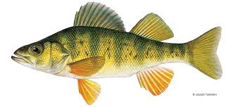
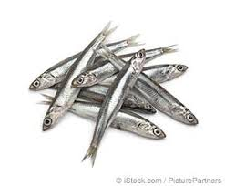
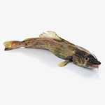
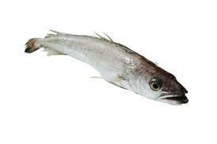
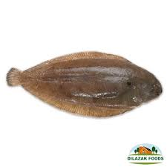
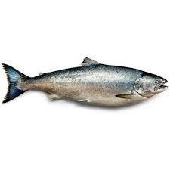
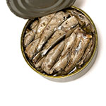
CARP
TROUT
PERCH
ANCHOVY
HAKE
COD
SARDINES
SOLE
SALMON

Slide 5
